Slide 1

Mariam Rahman
Welcome
ID : 17201046
Sec : A2

Slide 2

Traffic Light Simulation

Slide 3

Problem Statement
Most of the time people doesn’t know how long they have to wait in a traffic signal. Thus they become impatient and cross the road avoiding the signal. This introduces life risk. Another thing is peoples tend to honk horns without no reason in a traffic jam and this results in sound pollution. So what if they knew how long they have to wait? Then they wouldn’t break the law or wouldn’t honk.

Slide 4

Solution
My solution for this problem is to develop a traffic light system that will have a counter integrated with it. I will develop a prototype simulation of this system.

Slide 5
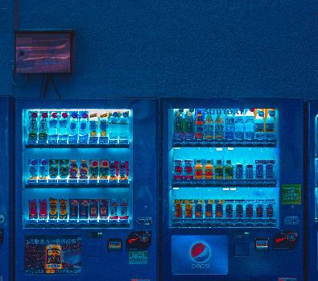


Software List
Arduino IDE (For code development part)
Proteus 8.9 (Simulation software)
In the simulation software we’ll use
- 7 segment display
Registors
Arduino Uno
Red, Green & Yellow led

Slide 6
Working Procedure
In each Red and Green signal the counter will count down from 9 to 0 and show it in the 7 segment display. And for the yellow signal the counter will count down from 1 to 0 and show it in the 7 segment display. In the real life scenario this will help the people to understand how long they should wait.

Slide 7
Project Status
Date | Completion
12.08.2020 | 0%
14.08.2020 | 10%
17.08.2020 | 50%
16.08.2020 | 60%
02.09.2020 | 100%(Probably)

Slide 8

Any Question?

Slide 9
THANK YOU!
www.proseware.com

